Slide 1

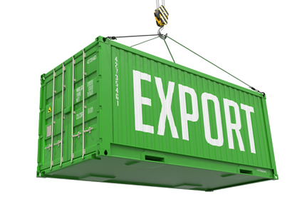
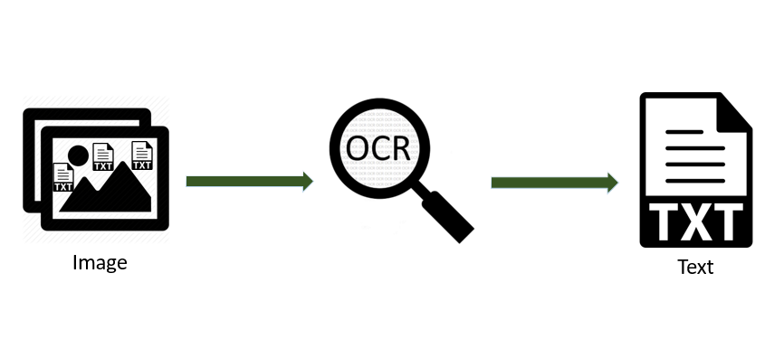
OCR for Customs Declarations and Transport Documents
Context:
Scanned customs declarations and other transport documents
Various document types with predefined structure and content
Different scanning devices and human error in the execution of the scan which affects the image quality
Task:
Optical charachter recognition (OCR) of scanned documents
Extraction of important information from the image
Classification of the document types
Transform output data in EDI (and other formats) for interface connection
Performance:
Human supervision because of incomplete classification is to be reduced to a minimum
Missclassification leads to processing wrong information
High accuracy is needed

